Slide 1
Cloud Computing
SEWP ZG527

Slide 2
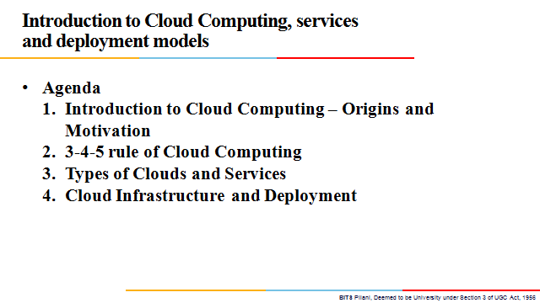

Slide 3
Cloud Computing: Definition
The US National Institute of Standards (NIST) defines cloud computing as follows:
Cloud computing is a model for enabling ubiquitous, convenient, on-demand network access to a shared pool of configurable computing resources (e.g., networks, servers, storage, applications, and services) that can be rapidly provisioned and released with minimal management effort or service provider interaction.
Notes:
RL 1.2

Slide 4
3-4-5 rule of Cloud Computing
NIST specifies 3-4-5 rule of Cloud Computing
3 cloud service models or service types for any cloud platform
4 deployment models
5 essential characteristics of cloud computing infrastructure

Slide 5
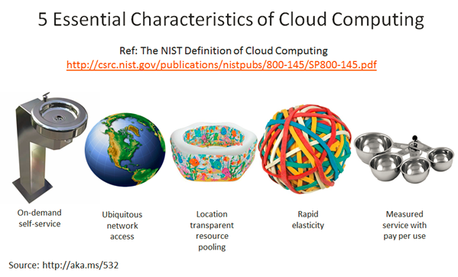
Characteristics of Cloud Computing
On demand self-service
Broad network access
Resource pooling
Rapid elasticity
Measured service

Slide 6
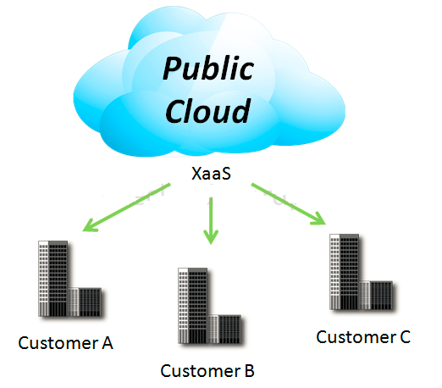
4 Deployment Models
1. Public Cloud
Mega-scale cloud infrastructure is made available to the general public or a large industry group and is owned by an organization selling cloud services.
Notes:
XaaS is Anything as a service
[http://www.definethecloud.net/cloud-types/]

Slide 7
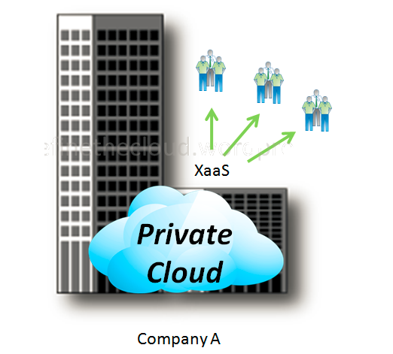
4 Deployment Models
2. Private Cloud
The cloud infrastructure is operated solely for an organization. It may be managed by the organization or a third party and may exist on premise or off premise.

Slide 8
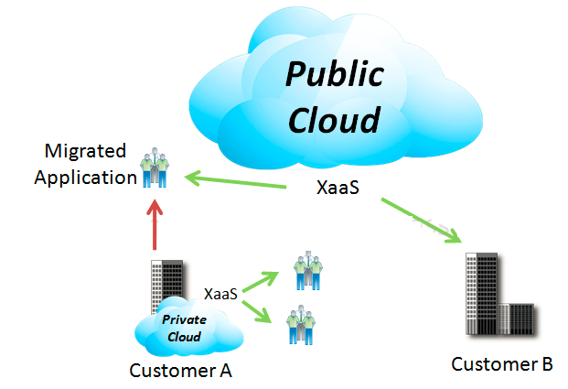
4 Deployment Models
3. Hybrid Cloud
The cloud infrastructure is a composition of two or more clouds (private or public) that remain unique entities but are bound together by standardized or proprietary technology that enables data and application portability

Slide 9
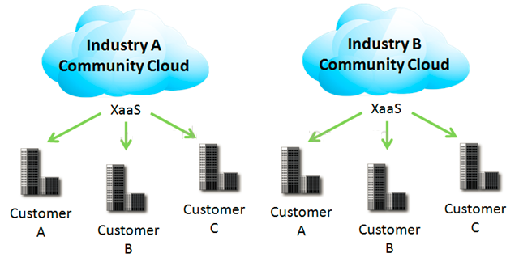
4 Deployment Models
4. Community Cloud
Community Clouds are when an ‘infrastructure is shared by several organizations and supports a specific community that has shared concerns (e.g., mission, security requirements, policy, and compliance considerations). It may be managed by the organizations or a third party and may exist on premise or off premise’ according to NIST.
A community cloud is a cloud service shared between multiple organizations with a common tie/goal/objective.
E.g. OpenCirrus

